Slide 1
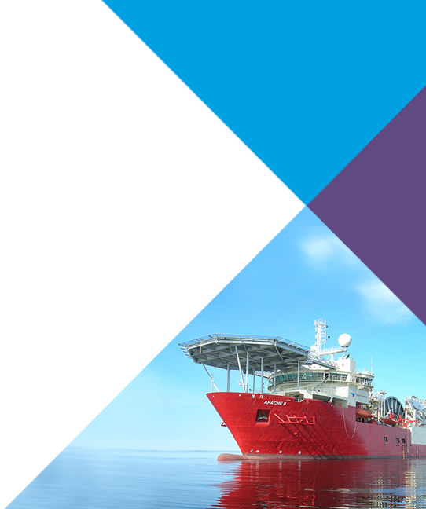
QER – 6806
QER: GUMUSUT KAKAP PHASE 4 SF300505C004.11+12+13 - Zeta wire weld crack

Slide 2
Pipe section / Details
Item | Traceability / identification
Project number | 300505C004
Project name | GUMUSUT KAKAP GERONGGONG JAGUS EAST PHASE 4
Pipe section | SF300505C004.11+12+13
ST number | ST127.70305
Affected layer / equipment | Pressure Vault Spiraling
Length affected | 77.1m
Drawing number / MP code / STA / Dimension | Zeta 8 FI09 (MP234)

Slide 3
Overview of anomaly (Cont)
Problem Description:-
During the zeta spiraling process of GUMUSUT KAKAP GERONGGONG JAGUS EAST PHASE 4 SF300505C004.11+12+13 (ST127.70305), zeta wire weld crack was detected at length 77.1m on pipe.
To note that, the affected weld from winding process and it was detected during weld inspection after laid on the pipe.
Details of affected weld are as the following:-
- Weld number : 04-03
- Welding machine : BS13-11
- Bobbin number : 014
Root Cause:-
The root cause was suspected due to inclusion as no anomalies were found on the machine (mechanically, power supply and forging distance).

Slide 4
Overview of anomaly
Problem Handling:-
The defective weld was rejected according to DP-QCP-08DAQT001. Therefore, un-spiraling was performed to remove the defective weld. In addition, based on DI-IND-MET1075, the subsequent welds shall be retrieved if reachable for the test and analysis. The subsequent welds were gone through the tensile test, and the result is detailed below.
Tensile results for the subsequent welds: -
- Weld 03-03 (N-1) = 586.7mPa
- Weld 06-03 (N+2) = 636.6mPa
The minimum criteria for the tensile test are 530mPa
To note that, N+1 weld are not reachable due to being laid on a pipe at length 59.9m.

Slide 5
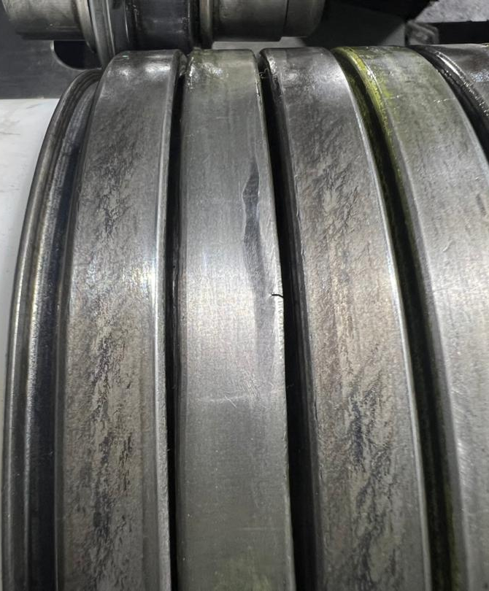
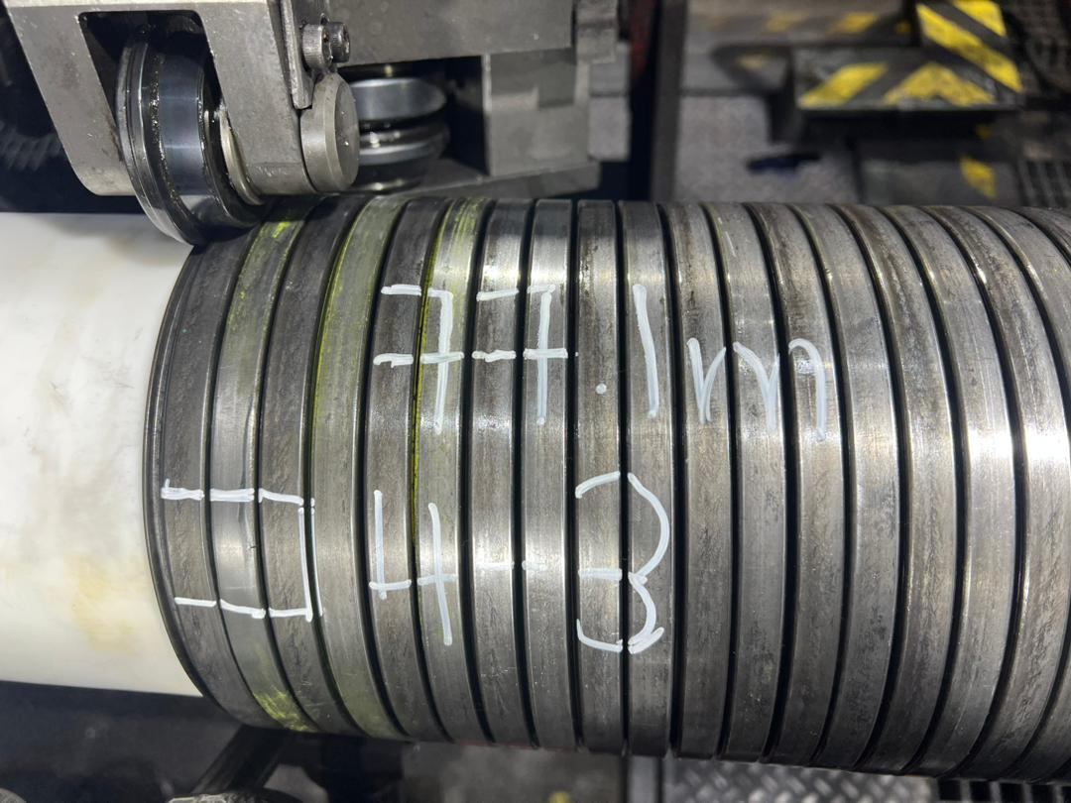
Defect Photo
Figure 1 : Zeta wire weld crack was detected at length 77.1m on pipe.

Slide 6
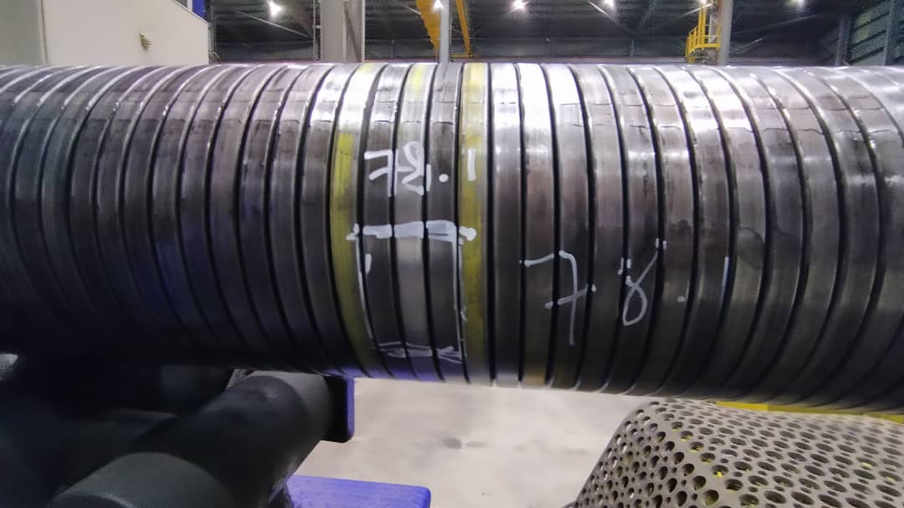
Photo after repaired
Figure 2 : Un-spiraling was performed to remove the defective weld and replaced new weld (07-08)

Slide 7

THANK YOU

